Slide 1


Pirate Fives
Aaron Loh, Arisa Toyosaki, Liam Flahive

Slide 2





Premise
UNITS
DEFENSE
SPECIAL
2 players, 3 types of cards, 5 cards dealt

Slide 3

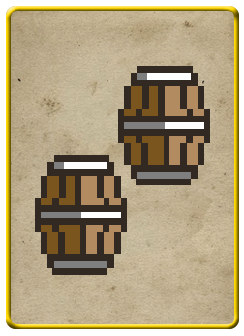

Premise
Different combinations of cards yield different results
= 1 unit of ship + Small health for all units + Small special damage

Slide 4
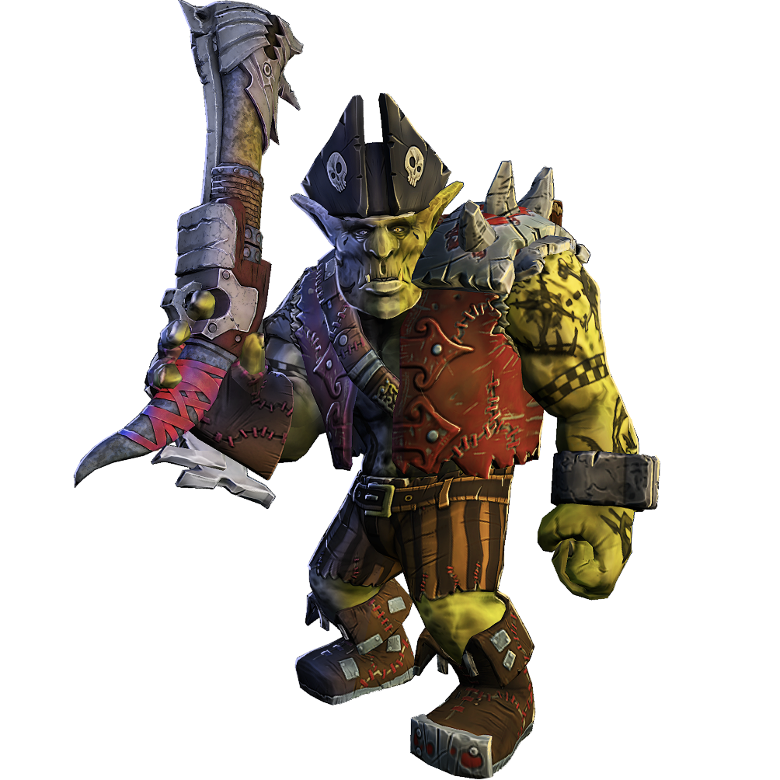
Premise
vs.
Goal: Take down enemy team captain

Slide 5
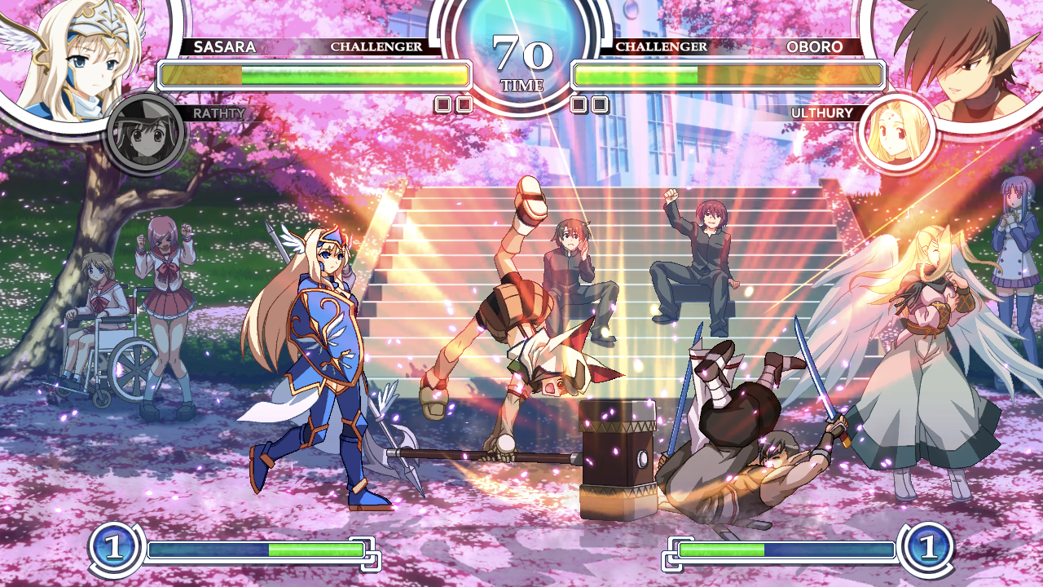
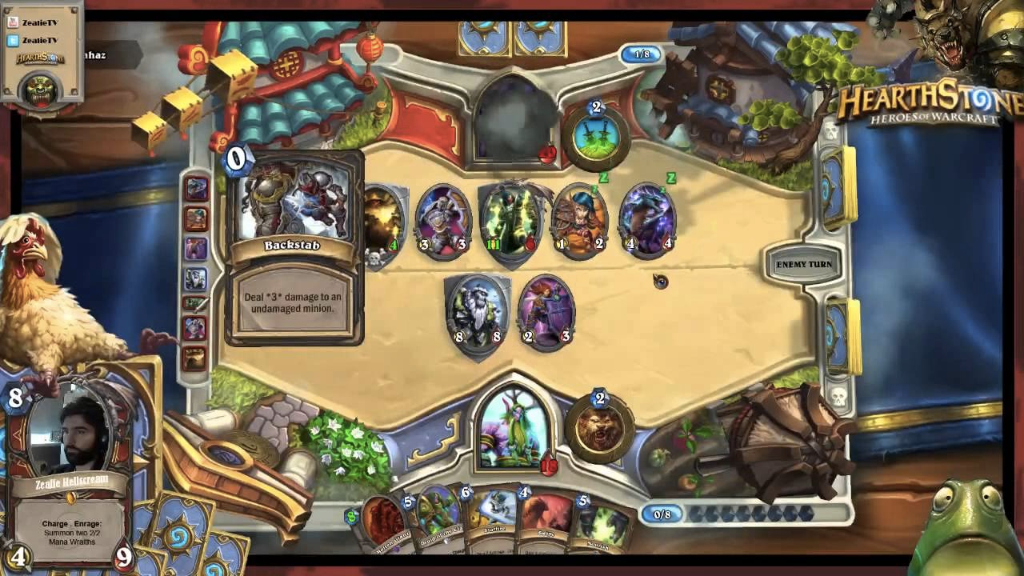
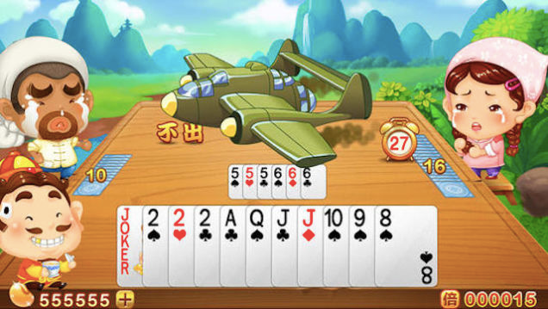
Inspiration
2D Strategy Games + Card Games

Slide 6


Key Components
+
+
Luck
Strategy
Progression
Player can take a risk
to draw a second time
Certain units only
attack specific units
Optimal strategy changes
as game progresses

Slide 7
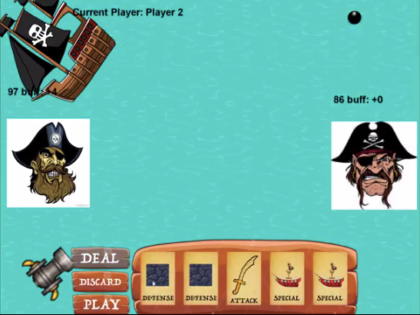
Current Progress
Completed:
Game Logic
Scoring
Player turns
Next up:
Improved graphics
More exciting win state
Game-balancing

Slide 8
Demo
https://youtu.be/gvlb0Q4Cseg

Slide 9
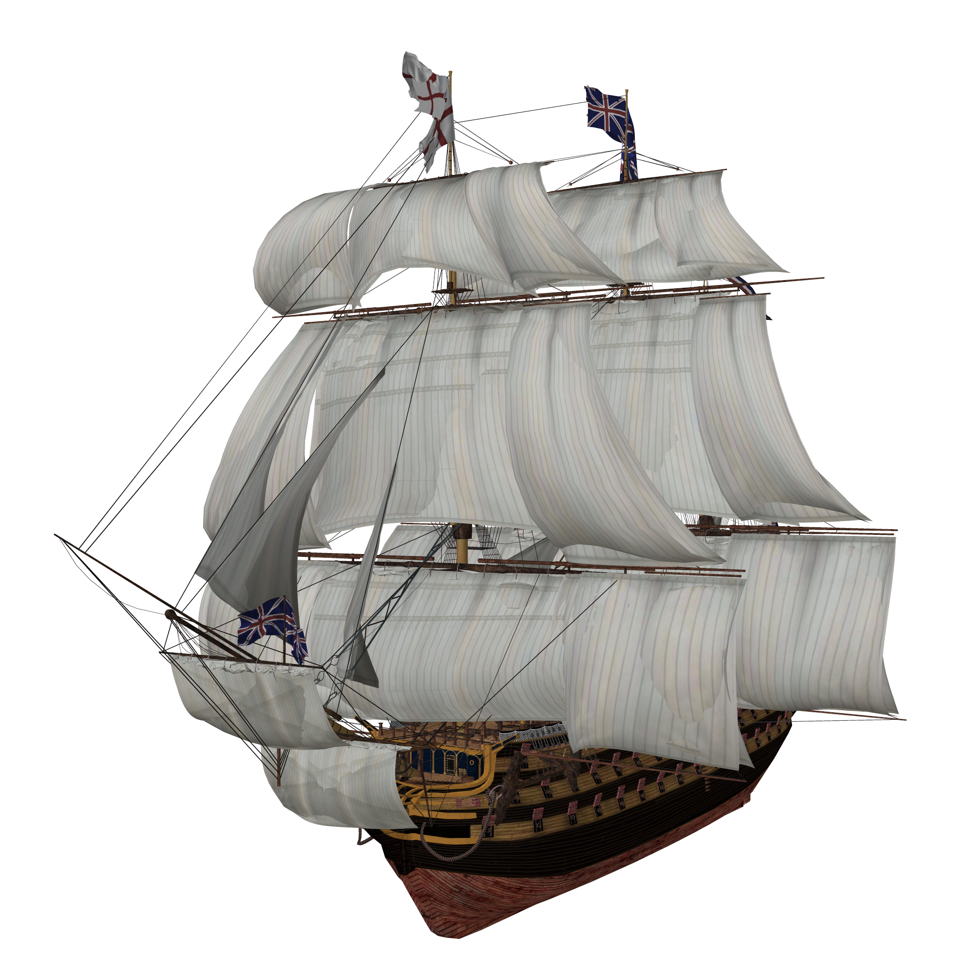
Questions?

